Slide 1

Welcome to !
LSM3257

Slide 2

Many people think that the sign over our module “gate” reads…
Dante (1320). “Divine Comedy”.

Slide 3




But there is hope!
“After this module, I can analyse data through R, it is very useful”
“What has been taught will be very useful and applicable in other modules/ future projects – good skill to acquire.”
Student A
Student C
“Challenging but very applicable and useful”
“Challenging but interesting.”
Student B
Student D

Slide 4
Why is LSM3257 challenging?
Learning to write a new language
★ ★ ★ ★ ★
Learning to analyse data
★ ★ ★ ★ ★
LSM3257
★ ★ ★ ★ ★ ★ ★ ★ ★ ★
Take home message: be prepared to work hard … but it will be rewarding!

Slide 5
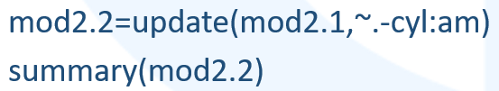
Module Overview
Designed to teach practical skills: so you’ll learn by trying and doing!
At the end of this module, you will be able to:
Understand R code
Write R code to perform and troubleshoot a data analysis
Identify and install new R packages that may be relevant to your study
Critically analyse the quality of data and data analyses
Bring a study through: from research question → identifying relevant data → data analysis & interpretation → conclusions

Slide 6
Module Overview
Week 1
Basic R coding
Data exploration and visualisation
Basic statistical concepts & tests
Regression
ANOVA & ANCOVA
Mixed Effects Models
Generalised Linear Models
Survival Analysis
Generalised Additive Models
Multivariate statistics
Bayesian statistics
Performing and presenting your analysis
R programming
Basic concepts & analyses
More advanced analyses
Brief introduction
Week 13
Practise through assignments

Slide 7
Module Overview
Practical, Practical, Practical!

Slide 8


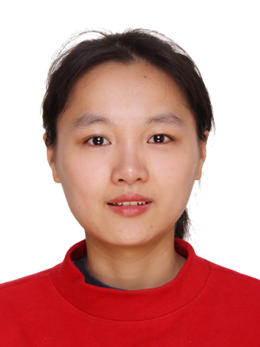
The Teaching Team
Dr Ian Chan
Lecturer
ianchan@nus.edu.sg
Ma Jinqi
Teaching Assistant
jinqima@nus.edu.sg
Su Tingting
Teaching Assistant
e0983569@u.nus.edu

Slide 9
Housekeeping
Class issues
Layout not ideal: I will Zoom every class (and put the recordings up) so you can get a closer look on your own screen
Starved for power outlets: power extension bars for everyone!
8am timing: sorry, I’d change it too if I had the choice…
Fonts used
I will send slides in pptx format. If words in your slides look out of alignment, make sure you have the following fonts installed:
Agency FB
Calibri (Body)
Courier New

Slide 10
Basic Data Handling in R
Lecture 1
LSM3257
AY22/23; Sem 2 | Ian Z.W. Chan

Slide 11
Summary (Learning Objectives)
What is R?
- How to analyse data in R
Installing R
Starting an R Project
- Working folder
- R scripts and syntax
- Installing packages
Importing datasets in R: read_xl(), read.table(), read.csv()
Preparing your data
- Calculator
- Functions
- Objects: Vectors, Matrices, Dataframes
- Conditionals and loops

Slide 12
What is R?

Slide 13
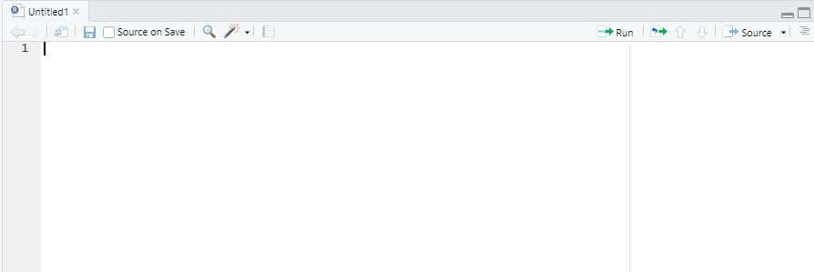
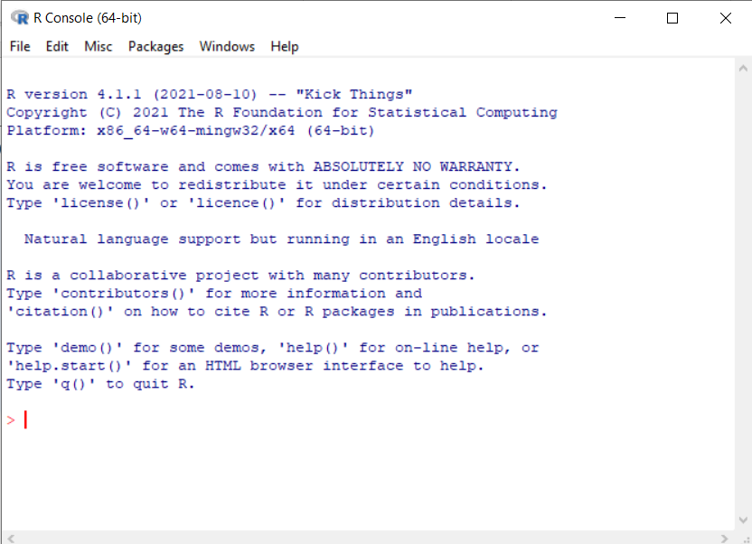
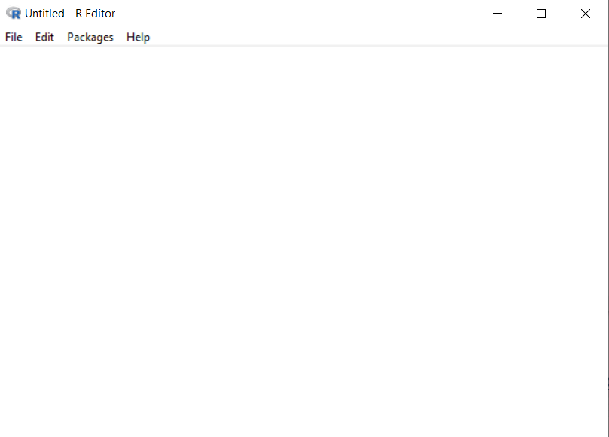
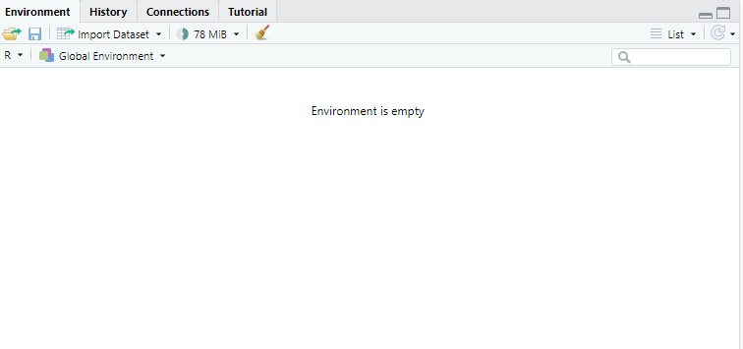
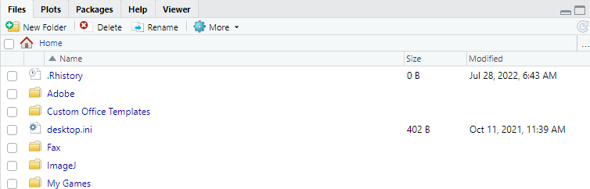
What is R
Note: “aka” = “also known as”
A program (aka “environment”) and programming language mainly used for data analysis/modelling
R Studio
Base R
Graphic User Interface
Source window
Console
Script
Similar to a Script (in Base R), press Ctrl/Cmd-Enter or click the “Run” button to run the code to the Console
Type your code here and press F5 to send them as commands to the Console
Environment window
The “heart of R”: evaluates your commands and does the analysis
Displays the datasets and other objects you have created/added
Cloud
Package A
Packages run your commands and do analysis
Some packages are preinstalled in Base R
Package D
Package B
Package E
Explorer window
Install more packages to run more sophisticated analyses
Package C
Package F
To navigate different things and display plots

Slide 14
What is R
Base R vs. R Studio
- Base R is just text; R Studio adds colours, autocomplete, error detection, etc.
- R Studio gives you more help so I recommend you start with that (I personally use Base R but I’m just a dinosaur)
- R Studio is a separate layer on top so you have to install Base R first then install R Studio
R in Windows vs. R in Mac
- Runs in both but with some minor differences (different installation file, Ctrl-Enter vs. Cmd-Enter, directories are specified differently, etc.)
- In both cases, you need to know how to navigate the folders and files in your computer!

Slide 15



What is R
R vs. Python
R Python
- Programming for data analysis - General purpose programming language
- More, and more powerful, statistical - Better for machine learning, web apps, packages integration with outside apps
- More complex language - Slightly simpler syntax
- Cunning, intelligent, detective work - Strong, elegant, wide range of abilities
But they both have one thing in common…
“I hate Excel”
“Me too”

Slide 16
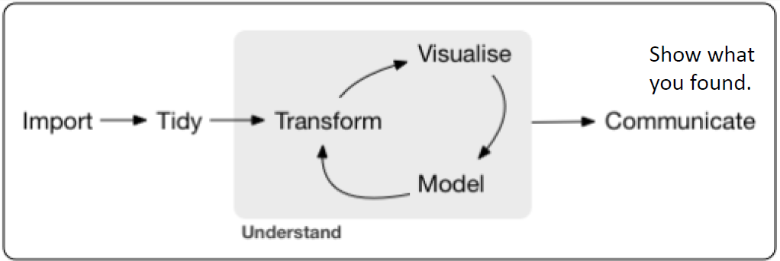
Data Science
How R fits into research and data science…
This module introduces you to this whole process
Data generated
(e.g. in an Experiment, from existing datasets)
Publish and/or present
(Prepare)
(Produce graphs and tables)
(Explore and analyse)
Grolemund (2017)

Slide 17
How to analyse data in R
1
Create an R Project
Install R (Base R and R Studio)
2
Today
Put all your datasets into the R Project folder and import your dataset(s) into R
3
4
Prepare your data
Explore and visualise your data
5
Next week (and beyond)
Analyse your data
6

Slide 18
Installing R

Slide 19
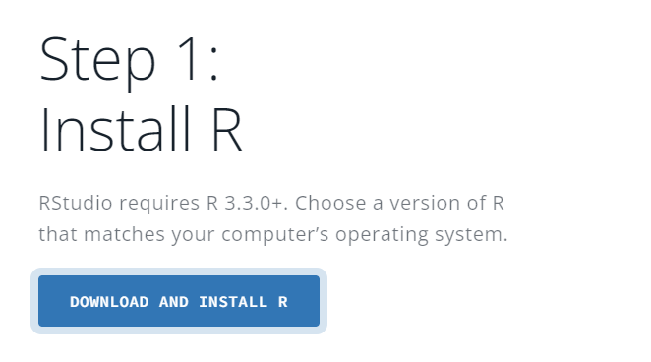
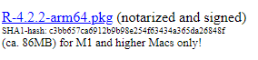
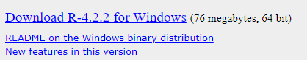
Download and installation
1) Go to: https://posit.co/download/rstudio-desktop/
2) Install Base R first:
- Click the “DOWNLOAD AND INSTALL R” button
- Download the software
- Complete the installation on your computer
For Macs
- Click “Download R for macOS”
- Click the latest package (e.g. “R-4.2.2.pkg”)
For Windows
- Click “Download R for Windows”
- Click “base”
- Click the “Download R-X.X.X for Windows”

Slide 20
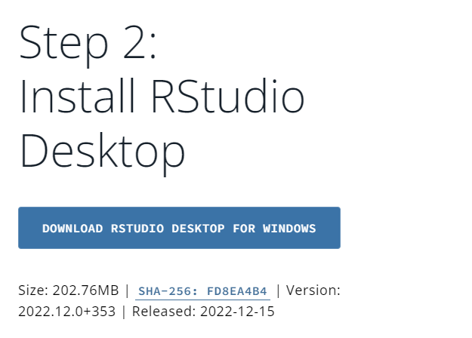
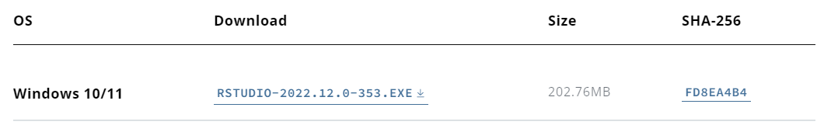
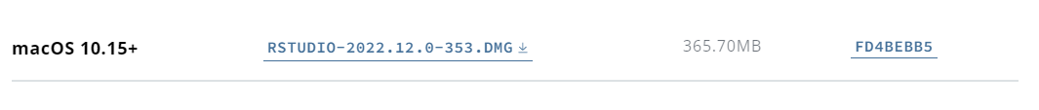


Download and installation
3) Install Rstudio:
- Download the installer
For Windows
- Click the “DOWNLOAD RSTUDIO DESKTOP FOR WINDOWS” button
(or you can scroll down and click this download link manually)
For Macs
- Scroll down and click the macOS 10.15+ download link
- Complete the Installation on your computer
4) Start up R Studio
- R studio will automatically start up Base R inside R Studio
- If you keep using R Studio, you will probably never have to start up Base R manually ever
Base R icon
R Studio icon

Slide 21
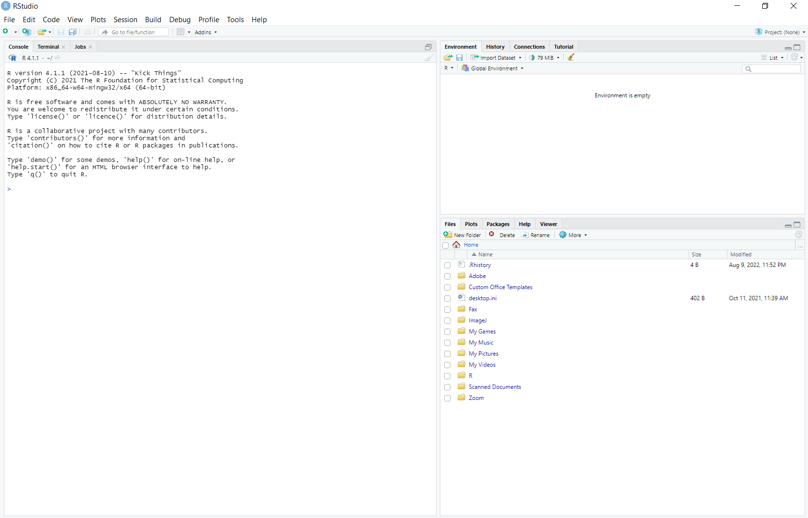
R Studio
On start-up…
Environment window
Imported/created objects
History of code
Console window
The code you run from the Source Window is processed here.
You can also run code directly here but limit this to simple calculations.
Source window
Explorer window
Displays Scripts which are the place to type your R code.
Need to open separately: File>New File or File>Open File.
Plots/figures you draw
Installed packages
File directory in your computer

Slide 22
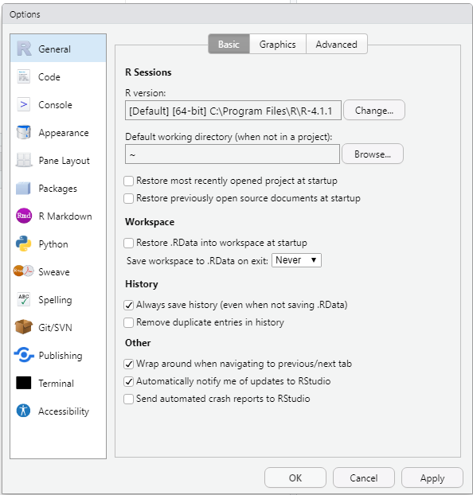
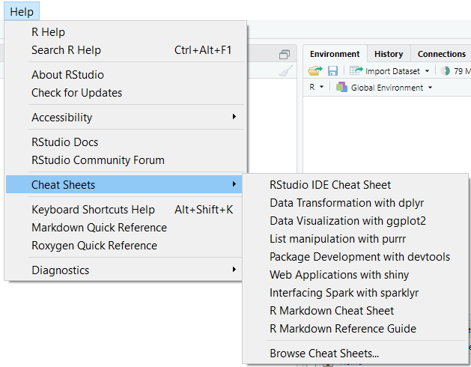
First-time startup settings
Turn on all diagnostics (we need all the help we can get).
- Click Tools>Global Options>Code>Diagnostics>Turn on everything
Clean up our workflow.
- Click Tools>Global Options>General>Basic
- Uncheck “Restore most recently opened project at startup”
- Uncheck “Restore previously open source documents at startup”
- Uncheck “Restore .RData into workspace at startup”
- Set “Save workspace to .RData on exit:” to “Never”
Cheatsheets (pdf downloads) are available in R Studio.
- Click Help>Cheatsheets

Slide 23
Starting an R Project

Slide 24
Create a new project
When starting a new analysis, first create a new R Project (one experiment → one R Project).
Create a folder where you want to store all your data for the study
Click File>New Project>Existing Directory
Click Browse>Select the folder you created>Click Open
Click Create Project (you should see a .Rproj file appear in that folder)
This is your Working Folder for this R Project
- Put all your datasets for your analysis in here
- Remember where to find it!
Pro tip: you may want to select the option to view file extensions to help you identify things more easily

Slide 25
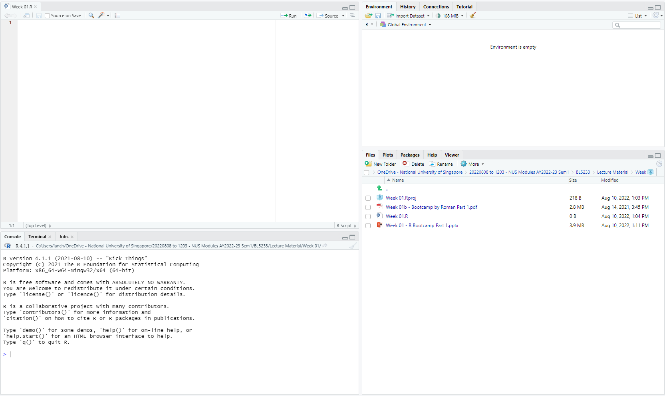
Create a new script
The first thing to do in a new project is to create a new script
File>New File>R Script
A new Source window appears in R Studio
Click the (very small) Save icon>Name your file whatever you want>Check that the script appears under Files in the Explorer window (you should also see it in your folder)
You type commands into the Script first and then run them to the Command Line
- It is not good practice to type code directly into the Console (except for simple calculations you don’t want to save)
Newly opened Source window
New file listed here
Pro tip: Continually use Ctrl-S / Cmd-S to save your script while you work!

Slide 26
R syntax: what to type in the Source window?
Commenting is writing text that is NOT run by R. The text is just for users to read.
We use it: (1) to remember what we are doing, and (2) to tell people reading our code what we are doing. Very important and good practice to use comments!
To tell R that some text is a comment, add a hex (#) at the beginning of the line or from the point where the comment starts.
Commands to tell R to do things: e.g.
dataset = read.table(“Data.txt”,header=T)
View(dataset) #This allows me to see my data
- Case sensitive: <dataset> ≠ <Dataset>.
- Commenting (using #) is useful!
- Commands are separated by a line break: one command, one line (you can get around this by using “+”, but more on this next time).
- If a command is not complete and you run it (e.g. you forgot to add a final close bracket), a “+” appears on the right of the line in the Console. If this happens, you get stuck. Press Esc and make the corrections.
- Both “<-” and “=” mean equals. “<-” is more explicit (you are assigning the item on the right to the item on the left) but I use “=”.
- Shortcut for “<-” in R Studio: Alt- – (hold down Alt and press minus)

Slide 27
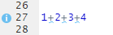
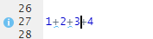
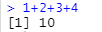
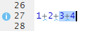
Running code from the Source window to the Console
Let’s say you want to calculate the value of “1+2+3+4”, so you type it into your Source window.
To run the whole line, place your cursor anywhere on the line and then press Ctrl-Enter or Cmd-Enter.
If you want to run only part of the line (e.g. only “3+4”), highlight that part and then press Ctrl-Enter or Cmd-Enter.
If you want to run multiple lines, highlight them (you can press Ctrl-A or Cmd-A to highlight all lines), then press Ctrl-Enter or Cmd-Enter.
Cursor here
Output in Console:
Highlighted here
Output in Console:

Slide 28
Installing packages in R
Packages allow you to do things, e.g. manipulate your data, do fancy plots, run advanced analyses
Some packages are automatically installed when you first install Base R, other packages you have to install yourself
Installation is a 2-step process:
# Step 1: Install the package
install.packages("readxl") #This package contains the read_excel() command
#Choose “Cloud” and click Enter (if asked)
#Step 2: Load the package (if you don’t do this, you cannot use it)
library(readxl)
With open and close inverted commas
Without inverted commas

Slide 29
To resume working on your project
1) Open the R Project file
Option 1: Open R Studio>File>Open Project
Option 2: Open the .Rproj file in the folder directly (easier)
2) In the Explorer window (within R Studio), open the R Script (.R file) in the R project folder
- All your previously saved code will appear in your Source window
3) Re-run whatever code is needed
- Re-load packages
- Re-import datasets, re-create objects

Slide 30
Importing datasets into R

Slide 31
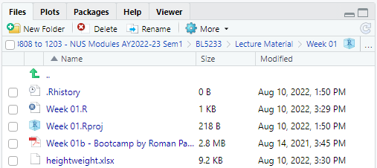
Put datasets into the Working Folder
Copy and paste the dataset (e.g. “Data.xlsx”) into your R Project folder, it should appear under Files in the Explorer window.
Now that your dataset is in your R Project Folder (aka your Working Directory), you can import the data into R using commands in R.
Dataset will appear here
Data.xlsx
If you’re using Base R, you will need to set your Working Directory to where your excel file is located using the setwd() command. For example, if I have stored my file “Data.xlsx” on my desktop, I will need to run:
In Windows
setwd(“C:\\Users\\Ian\\Desktop”)
#You have to use either two back slashes (\\) or one forward slash (/) to indicate folder levels
In Mac
setwd(“~/Desktop”)
#You use one forward slash (/) to indicate folder levels

Slide 32
Import the dataset into R
To read my Excel dataset (“Data.xlsx”) from the Working Folder into R:
Step 1: Install the “readxl” package.
install.packages("readxl") #This package contains the read_excel() command
library(readxl)
Step 2: Use the read_excel() command to import the dataset into R and save it to an object named <data1>.
data1 = read_excel(“Data.xlsx”) #The dataset is saved in an Object <data1>
data1 #Running this line of code will allow me to view the dataset in <data1>
Remember to save your data to an object, otherwise you won’t be able to use it later.
You can choose to have spaces around the “=“ or not. R understands both.
Two other (more difficult, but more traditional) ways to get data from Excel into R:
Save your file as a tab-delimited .txt file in Excel (File>Save as) → Use read.table() Must specify that your variables have a header row, e.g. read.table("Data.txt",header=T).
Save your file as a CSV .csv file in Excel (File>Save as) → Use read.csv() No need to specify, e.g. read.csv("Data.csv")

Slide 33
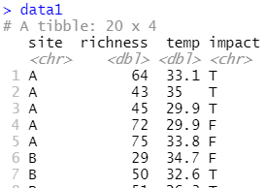
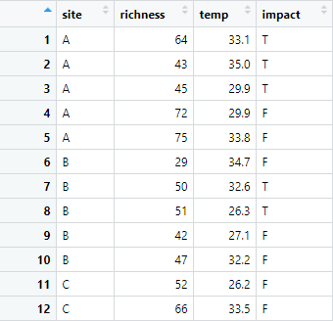
View the imported dataset
data1 #Shows either the first 10 rows or the whole dataset
head(data1) #Shows the first 6 rows of the dataset
tail(data1) #Shows the last 6 rows of the dataset
View(data1) #Shows the dataset in a nice table in the Source window
- Can also click on the dataset in the Environment window
str(data1)
- Gives you important information about the dataset and variables (we’ll learn more about this later)

Slide 34
Preparing the data
This is like learning a language, you’re not going to remember all the words immediately—don’t be discouraged!
Just remember it can be done and refer back here to see the exact code required.

Slide 35
R is a calculator
5+7 #This code outputs the answer in the Console
9-1
3*4
7/2
2^3
(5+7)/4^2
4%%3 #Modulo, i.e. finds the remainder
e1=5+7 #This code assigns the answer to the object <e1>
e2=9-1
e3=3*4
e4=7/2
e5=2^3
e6=4%%3
Object naming rules
You can name your objects anything you want, except you…
- CANNOT begin with a number or symbol: 1data or $data
- SHOULD NOT contain a symbol (&, $, <, etc.)
- CANNOT have spaces in the name
Tips
Use names that make sense: height, age
Use a naming convention: this_is_snake_case, thisIsCamelCase, this.uses.periods
Assigning values to objects

Slide 36
Functions do things to objects
Objects
The nouns in R (i.e. the things that store information).
The information can be one number, many numbers arranged in a straight line, many numbers arranged in a grid, etc.
Functions
The verbs in R (i.e. the actions done to the Objects). Different functions are designed to act on different types of Objects.
This “log()” is a function. <e1> is an object that the function is performed on.
log(e1)
exp(e2)
sqrt(4)
log(e3,10) #Log base 10 of e3
factorial(5)
floor(5.1) #Rounds down
ceiling(5.1) #Rounds up
abs(e3)
cos(e4)
sin(e1)
tan(e2)
acos(0)
round(x,digits=0)
“digits” is an argument that must be provided to the round() function. Different functions need different arguments, and you just have to slowly learn them (like learning grammar in a language).

Slide 37
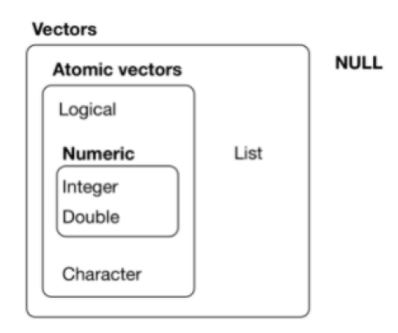
Different types of objects
Vector: many numbers (or other info) arranged in a one-dimensional row
v1=c(2,5,8,3,7,4,9,4) #A vector of with 8 elements, i.e. length=8
length(v1) #This would return 8
- A single value is a vector of length=1
- Vectors can store different types of information: numbers without decimal places (Integer), numbers with decimal places (Double), TRUE/FALSE (Logical), words/words with numbers (Character)
Matrix: multiple numbers (or other info) arranged in a two-dimensional rectangle
- Can only contain one type of information, e.g.:
Vector 1:
2 | 5 | 8 | 3 | 7 | 4 | 9 | 4
1 | 7 | 4 | 4 | 9 | 6 | 3 | 7
Vector 2:

Slide 38
Different types of objects
Dataframe: multiple numbers (and/or other info) arranged in a two-dimensional rectangle
- Different vectors can contain different types of information
- This is the type of object that is created when you read datasets in using read.table() and read.csv()
Tibble: a Dataframe with a few slight differences (used in Tidyverse)
- This is the type of object we will work with most of the time to store datasets because read_excel() creates this type of object
A word on Tidyverse
Tidyverse is a collection of R packages written by a lot of different researchers to try to make coding in R more friendly.
Some researchers feel that Tidyverse is the best thing in the world since sliced bread. I disagree: I think some aspects are great, some not so. So I’ll be introducing to you the great ones (e.g. ggplot2) and leaving out the others.
After the course, when you are more familiar with R, you can look up Tidyverse for yourself (https://www.tidyverse.org/) and decide whether you want to use all its functions.
Vector 1:
2 | 5 | 8 | 3 | 7 | 4 | 9 | 4
A | B | A | A | B | A | B | B
True | False | False | False | True | False | True | False
Vector 2:
Vector 3:

Slide 39
Some common functions for vectors
length() #Check the number of elements in your vector
mean()
median()
max()
min()
range() #Returns the smallest and largest values
sd() #Returns the standard deviation of the vector
var() #Returns the variance of the vector
sum()
prod() #Returns the product of all the elements
sort() #Returns a vector with the elements sorted from smallest to largest
rank(v1) #Returns the rank of each element from smallest (1) to largest (8, #because there are 8 elements in <v1>)
quantile()
sample(x,replace=T) #Samples values from the vector and replaces them
match(v1,v2) #Checks whether the elements in 2 vectors are identical
If I write something like that (with two brackets after), you know I’m referring to a function

Slide 40
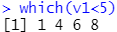
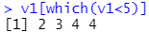
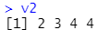
Extract values from vectors (subsetting)
To extract one or more element(s), we can use square brackets []:
v1=c(2,5,8,3,7,4,9,4)
v1[1] #Returns the first element: 2
v1[4] #Returns the fourth element: 3
v1[c(1,4)] #Returns a vector containing the first and fourth element: c(2,3)
To extract elements based on their value, we can use Logicals:
v1[v1<5] #Extracts the elements which are smaller than 5
v1[which(v1<5)] #This is equivalent to “v1[c(1,4,6,8)]”
v2=v1[v1<5] #To save all the values smaller than 5 in <v1> to <v2>
v2
Values 1, 4, 6 and 8 are smaller than 5, therefore TRUE
The command that was run: this command tells R to display whatever is in the vector <v2>
The values of the four elements in the vector
The numbering of the first element in this row (useful with long vectors that need more than one row to be displayed)

Slide 41
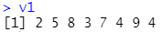
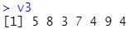
Editing values of elements
To change one value in the vector, we can use the square brackets again:
v1[1]=3 #This changes the value of the first element from 2 to 3
To change all values in the vector:
v1=v1+2 #Adds 2 to all the elements in <v1>
v3=v1[-1] #Removes the 1st element of <v1> and saves everything else in <v3>
But these kind of manipulations in R are a little inconvenient. My suggestion is to just do it in Excel and reimport the entire dataset.
Removing an element

Slide 42
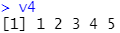
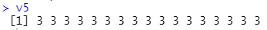
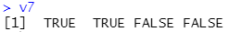
Creating vectors from scratch
Debugging Time!
Can you spot the error in this slide?
These all create the same vector:
v4=1:5
v4=c(1,2,3,4,5)
v4=seq(1,2,1) #seq(x,y,z): go from x to y, increasing by z each time
Or you can create a vector filled with only one value:
v5=rep(3,17) #rep(x,y): repeat x y-times
- We sometimes use this to create vectors of 0s before we assign values to each element.
To create vectors of words (characters) or True/False data:
v6=c("Red","Blue","Green","Yellow") #Must use inverted commas around each
v7=c(T,T,F,F) #True/False type data do not require inverted commas #Can also be entered as TRUE and FALSE
You just have to remember that this is how you string a few different values together in R
The seq() function requires you to provide 3 values for these 3 arguments.
Notes:
In “v4=seq(1,2,1)”, the “2” should be a “5”

Slide 43
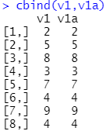
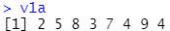
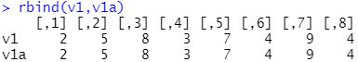
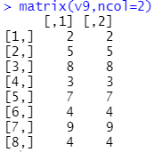
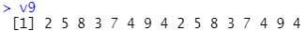
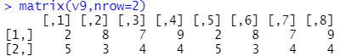
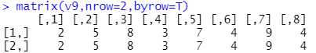
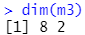
Combining vectors to make matrices
If you start with different vectors:
v1a=v1 #Duplicate <v1>
m1=cbind(v1,v1a) #Put the vectors together as two columns
m2=rbind(v1,v1a) #Put the vectors together as two rows
If you start from one long vector of all the values:
v9=c(v1,v1) #<v9> is <v1> repeated twice
m3=matrix(v9,ncol=2) #uses <v9> to create a matrix with the specified number of columns
m4=matrix(v9,nrow=2) #To create a matrix of 2 rows instead #not quite right because R fills up the elements top down first
m5=matrix(v9,nrow=2,byrow=T) #this is right!
dim(m3) #tells you the number of rows and columns in the matrix
Setting this argument to True tells R to fill the matrix by rows
Rows
Columns

Slide 44
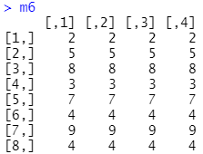
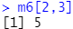
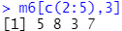
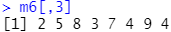
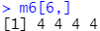
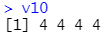
Extracting elements and vectors from a matrix
Referring to elements using the notation: [row,column]
m6=cbind(m3,m3)
m6[2,3] #Value in Row 2 of Column 3
m6[c(2,5),3] #Values in Rows 2 and 5 of Column 3
m6[c(2:5),3] #Values in Rows 2 to 5 of Column 3
#Leaving an argument out tells R that you want ALL rows/columns
m6[,3] #Values in all rows of Column 3
m6[6,] #Values in all columns of Row 6
v10=m6[6,] #You can save the rows/columns as new vectors

Slide 45
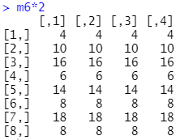
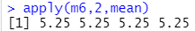

Working with whole matrices
Similar to vectors, you can add to, subtract from, multiply, etc. all elements in a vector at the same time:
m7=m6*2 #This multiplies <m6> by 2 and stores it in <m7>
If you want to apply a function by row/column, e.g. calculate the mean of all the columns in <m6>, you could do this manually for one column at a time (tedious), or you could use apply():
apply(m6,2,mean)
apply(m6,1,sum) #This calculates the sum of each row
In this matrix
Calculate the mean. This could instead be another function that works on vectors: e.g. sd, var, median
By columns (for rows, use “1” instead)
Mean of column 1
Mean of column 2

Slide 46


Extracting elements and vectors from a Dataframe
Column 1
Column 2
Identical to what you can do with a matrix
data1[11,1] #returns C
data1[6,3] #returns 34.7
Difference: the columns (variables) now have names
- You can use variable names to refer to columns: “$variable”
data1$temp #returns the whole of the <temp> column
data1$temp[6] #returns the 6th value in <temp>
#Can combine this with Logicals to get all values <30
tempLess30=data1$temp[data1$temp<30]
Row 1
1) Give me the position of the elements in <data1$temp> that are <30
2) Give me the values in those elements
3) Store the values in this new object

Slide 47

Create a new variable (column) in a Dataframe
To create a new column, all you have to do is specify a new variable.
Let’s say we want add a new variable called <country> to <data1> with the first 10 values being “X” and the next 10 values being “Y”:
cy=c(rep("X",10),rep("Y",10)) #creates a vector <cy> with the specified data
data1$country=cy #This command creates the new variable
<country> added here
The dataframe previously did not have a variable called <country>
I’m assigning the values in <cy> to this new variable

Slide 48

Working with Dataframes
With dataframes, we seldom want to calculate the mean for ALL columns because they have different types of variables. Usually we want to calculate the mean (or sd, sum, prod, etc.) of one specific column:
mean(data1$richness) #to calculate the mean of richness
Another thing we often want to do is apply the calculation based on groupings defined by another variable. For example, you want to find the mean <richness> of <site> A, B, C and D separately. You can use tapply():
tapply(data1$richness,data1$site,mean)
For this variable
Grouped according to this variable
Calculate this
Mean richness for <site> A

Slide 49




Conditionals
Often, you may want to apply a transformation to certain elements in a vector.
v10=c(-1,3,0,5,-4,3)
#I want to change all elements <0 to 0
v10[v10<0]=0
#I want to multiply all elements <0 by 2
v10[v10<0]=v10[v10<0]*2
You may also want to perform a certain command only if a condition is met.
if(mean(v10)>5){
v10=v10*2
}else if(mean(v10)>=0){
v10=v10*1.5
}else{
v10=v10+1
}
Operators in R
For a list of operators (equals, not equal, greater than, less than or equals, etc.): Google, or see HERE.
If this condition is met
What I want to do:
Do this command
v10+1
v10*1.5
v10*2
mean(v10)
0
5
Otherwise, if this condition is met
In this example, mean(v10) = 1, so we did v10*1.5:
Do this command
Otherwise
Do this command

Slide 50
Loops
To do things repeatedly (iteration) in R.
- Loops are great but they tend to slow down your code so avoid them if you can (e.g. use apply() or perform transformations on whole vectors/matrices like we learnt previously).
- We will use very little loops in the semester.
2 main types:
1) “While” loops (when you do NOT know how many times you need to do something)
While(this condition is true){
Do these instructions
}
2) “For” loops (when you know how many times you need something repeated)
For(as long as this condition is true){
Do these instructions
}
This curly bracket denotes the start of the commands to be repeated
This curly bracket denotes the end of the commands to be repeated

Slide 51


“While” loop
Imagine we want to roll a dice until we get a 6 and see how many times we rolled:
myDice=1:6 #First we create the dice
sample(myDice,1,replace=T) #This ‘rolls’ the dice
#We don’t know how many times to roll, so we use a While loop
allRolls=0
lastRoll=0
while(lastRoll!=6){
lastRoll=sample(myDice,1)
allRolls=c(allRolls,lastRoll)
}
#Number of rolls needed
length(allRolls[-1])
#Record of rolls
allRolls[-1]
From the values in <myDice>
And make the chosen value available again (not really needed for this example)
Choose 1 value
This means not equals
This is the loop: note how the curly brackets are indented. This is to help us see clearer.
Outputs the number of rolls needed to get a 6
Outputs the history of all the rolls

Slide 52

“While” loop: a closer look…
This vector is used to store the history of all our rolls
As long as <lastRoll> is not 6, do all the commands in the curly brackets
This is used to store the most recent roll
Roll the dice and store the result in <lastRoll>
allRolls=0
lastRoll=0
while(lastRoll!=6){
lastRoll=sample(myDice,1)
allRolls=c(allRolls,lastRoll)
}
#Number of rolls needed
length(allRolls[-1])
#Record of rolls
allRolls[-1]
Goes back to check whether <lastRoll> = 6.
- If not, it carries out the commands again.
- If it is, it exits the loop and does the next instruction after the loop.
Add the most recent roll to the history of rolls
Outputs how many elements there are in our history of rolls (minus 1)…
We needed this 0 to start the vector. Now, to display the results, we remove it using [-1].
(There is another way of doing this but it involves using lists which we haven’t learnt.)
Outputs the whole history without the first element

Slide 53


“For” loop
From <data1>, we want to model future temperatures over the next 10 years based on current <temp>, assuming a 1% increase per year.
#Create a matrix to store the data
futureTemps=matrix(rep(0,20*10),nrow=20)
futureTemps=cbind(data1$temp,futureTemps)
#Then we could do this manually
futureTemps[,2]=futureTemps[,1]*1.01
futureTemps[,3]=futureTemps[,2]*1.01
futureTemps[,4]=futureTemps[,3]*1.01
futureTemps[,5]=futureTemps[,4]*1.01
futureTemps[,6]=futureTemps[,5]*1.01
… … … …
futureTemps[,11]=futureTemps[,10]*1.01
Creates a 20 by 10 matrix of 0s
+
Put another column with current temperatures in front
#Or, since we know we need to do this 10 times, we could use a For loop:
for(i in 1:10){
futureTemps[,i+1]=futureTemps[,i]*1.01
}

Slide 54

“For” loop: a closer look
Creates a dummy variable <i> that starts at the first number, increases by 1 each time it goes through the loop, and stops when it is greater than the second number.
#The loop
for(i in 1:10){
futureTemps[,i+1]=futureTemps[,i]*1.01
}
As long as <i> is between these two numbers (inclusive), the commands in the loop will be carried out
Increases the values from the previous column by 1%
Starts at column 2. As <i> increases, it will move to column 3→4→5→etc.
with one line of code

Slide 55
Help in R
How do I know what arguments a function needs?
- Look for built-in help in R
help(mean) #can be a function or a package
?mean #opens documentation in R
??mean #used if there is no documentation in R, opens from the web
- Vignettes (search the function name and “R vignette”)
I don’t even know what function I need!
- https://stackoverflow.com
- http://cran.r-project.org
- Google (especially error messages)

Slide 56
Summary (Learning Objectives)
What is R?
- How to analyse data in R
Installing R
Starting an R Project
- Working folder
- R scripts and syntax
- Installing packages
Importing datasets in R: read_xl(), read.table(), read.csv()
Preparing your data
- Calculator
- Functions
- Objects: Vectors, Matrices, Dataframes
- Conditionals and loops

Slide 57



Next week…
Data exploration and visualisation!

Slide 58
Module Information
Lecture 1
LSM3257
AY22/23; Sem 2 | Ian Z.W. Chan

Slide 59

Assessments
100% CA
Full details in Module Guide
Take home assignments:
- Similar to HEx but more challenging
- Open everything but please no discussion
Assignments to practise what you learn in class

Slide 60
Hands-On Exercises (HEx) (20%)
Weeks 1, 2, 3, 6, 7 and 8 only.
Download the questions (a .R file) from Canvas before lecture. Start attempting during lecture (we will help). Continue doing at home. Submit the completed .R file on Canvas by the deadline (1 week after the class).
If pictures/plots are asked for, paste all of them onto a Word document (will be provided) and submit it too.
Marked only based on whether you’ve genuinely attempted the question, NOT on whether the answer is correct or not.
- Marks in the assignment are just indicative of how complicated the answer is
See Module Overview pdf for more details.

Slide 61
Analysis Challenges (20% x 2)
2 challenges (instead of 2 mid-terms from last year)
- Challenge 1: covers Weeks 1–6; released Week 6, submit by 24 Feb 2359h (2 weeks)
- Challenge 2: covers mainly Weeks 7–10; released Week 10, submit by 31 Mar 2359h (2 weeks)
Similar to the HEx but more difficult
Open universe (to make it as authentic as possible)
But please do not discuss with your friends
- This will force you to learn it for yourself so you actually benefit from the assignment

Slide 62
Project (35%)
In groups of 3 to 4…
Find a dataset, choose variables, formulate a research question, analyse the data then present and write a concise research article.
Ideally, the dataset would be related to your work or research
From supervisor/colleagues: datasets which have not yet been analysed
Data from international agencies or published papers in open repositories (e.g. http://datadryad.org/)
1) Submit a Proposal (5%) as a group: describe background (why is your question important), the research question you came up with and the dataset to be used. Similar to an Abstract but without results and conclusions. ≤ 300 words. Due on 12 Feb 2359h.
- Refer to research papers to see how Abstracts are written
- This is mainly for me to give you feedback and make sure you’re on the right track

Slide 63
Individual Project (35%)
2) Presentation (15%) as a group: describe background, research question, data used AND results and conclusions. 10 minutes followed by Q&A. Weeks 12–13 (come on the week you’re presenting). Submit slides the day before your slot.
- Use nice graphics and tell an interesting story that laymen can understand
3) Report (20%) individually: describe background, research question, data used, and results and conclusions. ≤ ~2500 words. Due on 28 Apr 2359h.
- Refer to research papers to see how they write. If you need help with scientific writing, please email me and we will advise you.
See the Module Overview pdf for full details: refer to the rubrics often!!
Teammate grading is available as a last resort. My email/door is always open.

Slide 64


Key Values
Honesty
- We do not plagiarise: i.e. take existing work (even your own) and pass it off as new work for this module. When in doubt, cite your sources (even yourself!)
https://www.nus.edu.sg/celc/programmes/plagiarism.html
We do not copy others’ work
Respecting others
- We will foster a safe and positive learning environment: NO discrimination, NO personal attacks, critique the idea NOT the person
- We are responsible for our own learning
- We will try to help one another along the way

Slide 65


Readings
Our 2 "textbooks" are:
- The R Book (main), and
- Introduction to R (supplementary).
There are also links to videos for some weeks in the Module Overview (under Schedule and Readings).

Slide 66

Schedule

Slide 67
Project Preparation
Group Presentations
1) Form groups of 4 (ideally) or 3 (if you really must)
2) Indicate your groupings in Canvas>BL5233>People>Groups
3) If you don’t have a group by next week, I will assign
Later on: we will assign presentation slots in Weeks 12 and 13
Group Members | Date | Slot
 | 9 Sep 22 | 1
 |  | 2
 |  | 3
 |  | 4
 |  | 5
 |  | 6
 |  | 7
 | 16 Sep 22 | 1
 |  | 2
 |  | 3
 |  | 4
 |  | 5
 |  | 6
 |  | 7

